Slide 1
Test Cases

Slide 2
Spatial Transformations

Slide 3
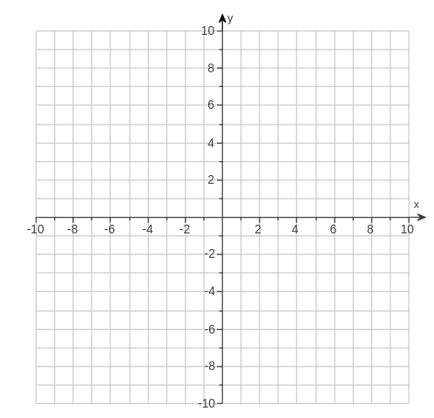
[90,0,0] Degrees about [2,2,0]
[2,2,0],[4,2,0],[4,0,0]
[2,2,0],[4,2,0],[4,2,-2]
[4,2,-2]
Z
Z

Slide 4
Clockwise 90 Degrees about [2,2,0]
[2,2,0],[4,2,0],[4,0,0]
[2,2,0],[4,2,0],[4,2,-2]
[4,2,-2]
Z
Z

